Slide 1
Beyond Infrastructure as a Service
Notes:
Introduction to the Cloud

Slide 2
Overview
Application Load Balancers
Content Delivery Networks
Object Storage
Databases as a Service
Functions as a Service
Containers as a Service
Stream Processing and Business Intelligence Tools
Deployment Pipelines

Slide 3
Beyond IaaS
PaaS: Platform as a Service

Slide 4
Beyond IaaS
IaaS: virtual machines
PaaS: managed services

Slide 5
Beyond IaaS
IaaS: for system administrators
PaaS: for developers

Slide 6
Beyond IaaS
Managed Application Load Balancer
VM
VM
VM
Managed Database

Slide 7

Application Load Balancers
Source: Unsplash/Maciej Rusek under Unsplash License

Slide 8
OSI model
Application
ALB
Presentation
Session
Transport
Network
Data link
Physical

Slide 9
Application Load Balancing
ALB
http://example.com/login
http://example.com/user
VM
VM
VM
VM
VM
VM

Slide 10

Sticky sessions
backend=a
ALB
VM
backend=a
VM
backend=b

Slide 11

Sticky sessions
backend=a
ALB
VM
backend=a
VM
backend=b

Slide 12
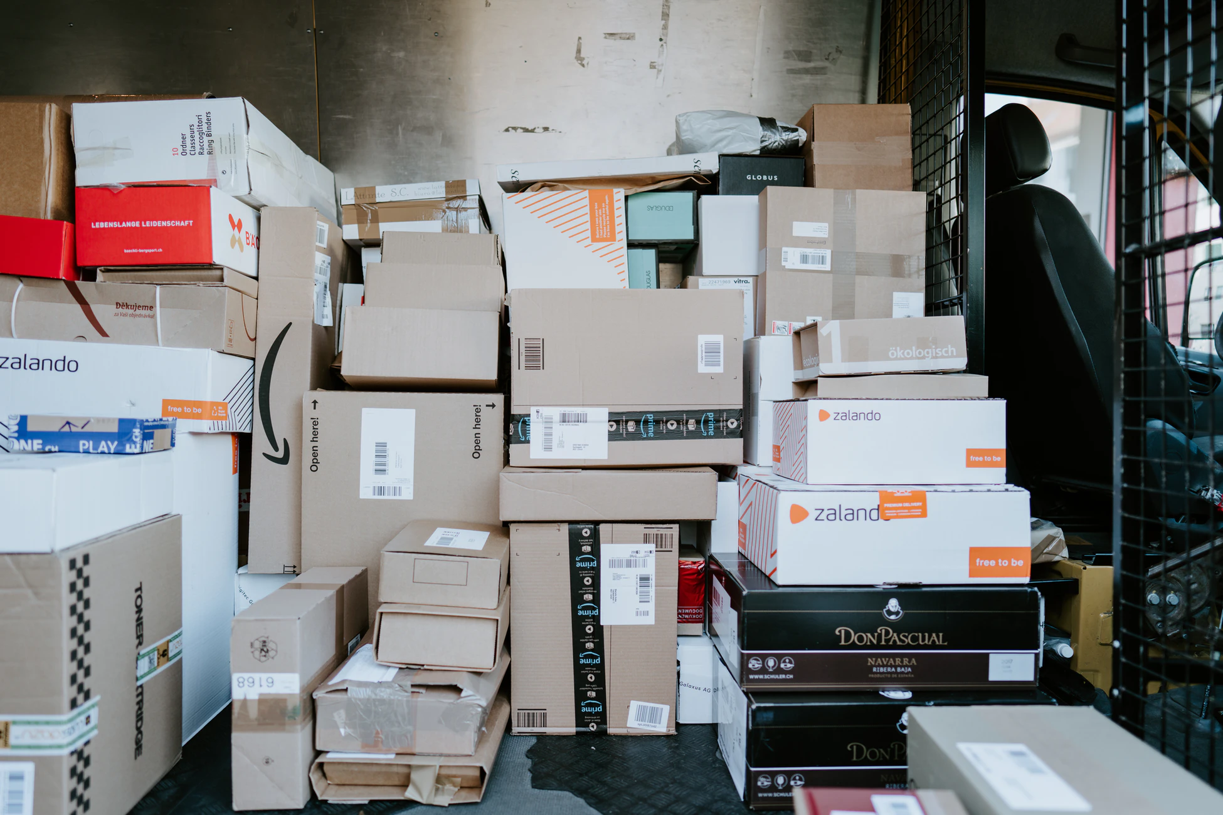
Content Delivery Networks
Source: Unsplash/Claudio Schwarz under Unsplash License

Slide 13

Fiber Optics
Theoretical: 113ms
Practical: ~300ms

Slide 14
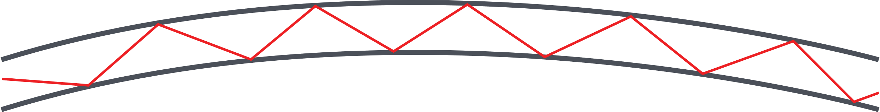
Fiber Optics

Slide 15
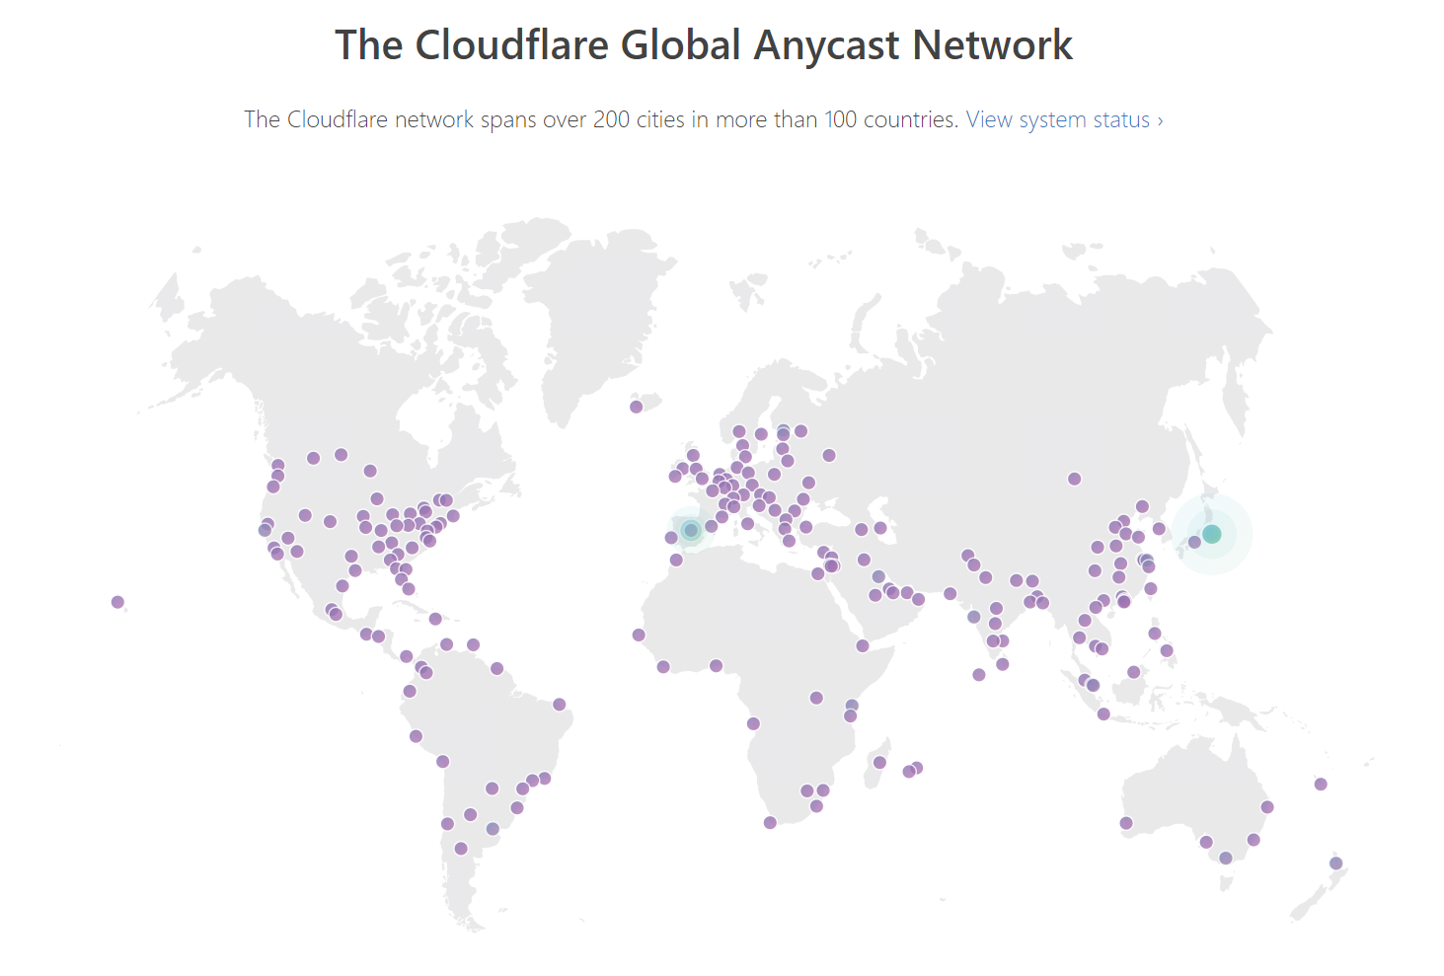
CDN

Slide 16
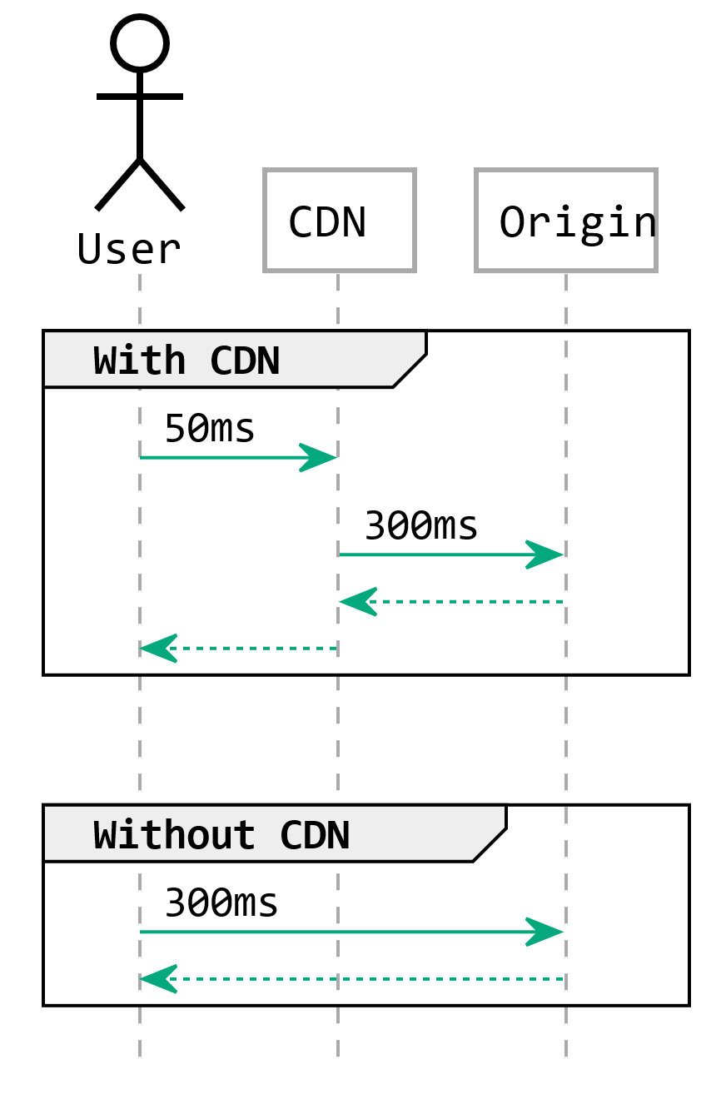
Caching

Slide 17
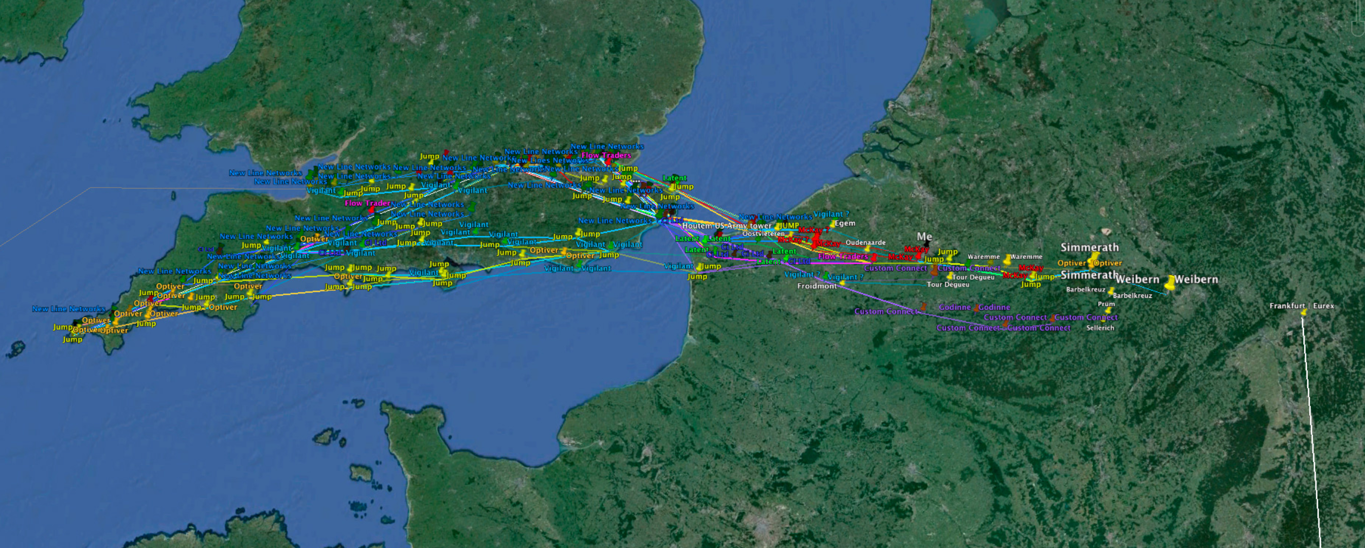
Frankfurt-London
| Source: Alexandre Laumonier

Slide 18

Starlink
| Source: SpaceX / starlink.com

Slide 19
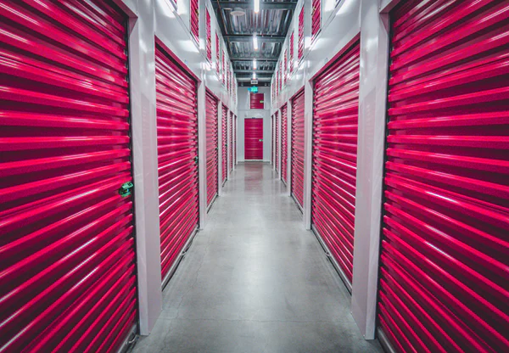
Object Storage
Source: Unsplash/Joshua Coleman under Unsplash License

Slide 20
Filesystems
Parallel file access
Partial reads/writes
Locking files

Slide 21
S3
Upload/download files
List/delete files
No consistency guarantee
Partial file operations not possible* * Except in a few special cases.

Slide 22
Object Storage
Redundant by design
Publish files without a webserver
Object Versioning
File overwrite prevention

Slide 23
Cold storage
Data stored offline (e.g. tape)
Recovery takes longer
Cheaper

Slide 24
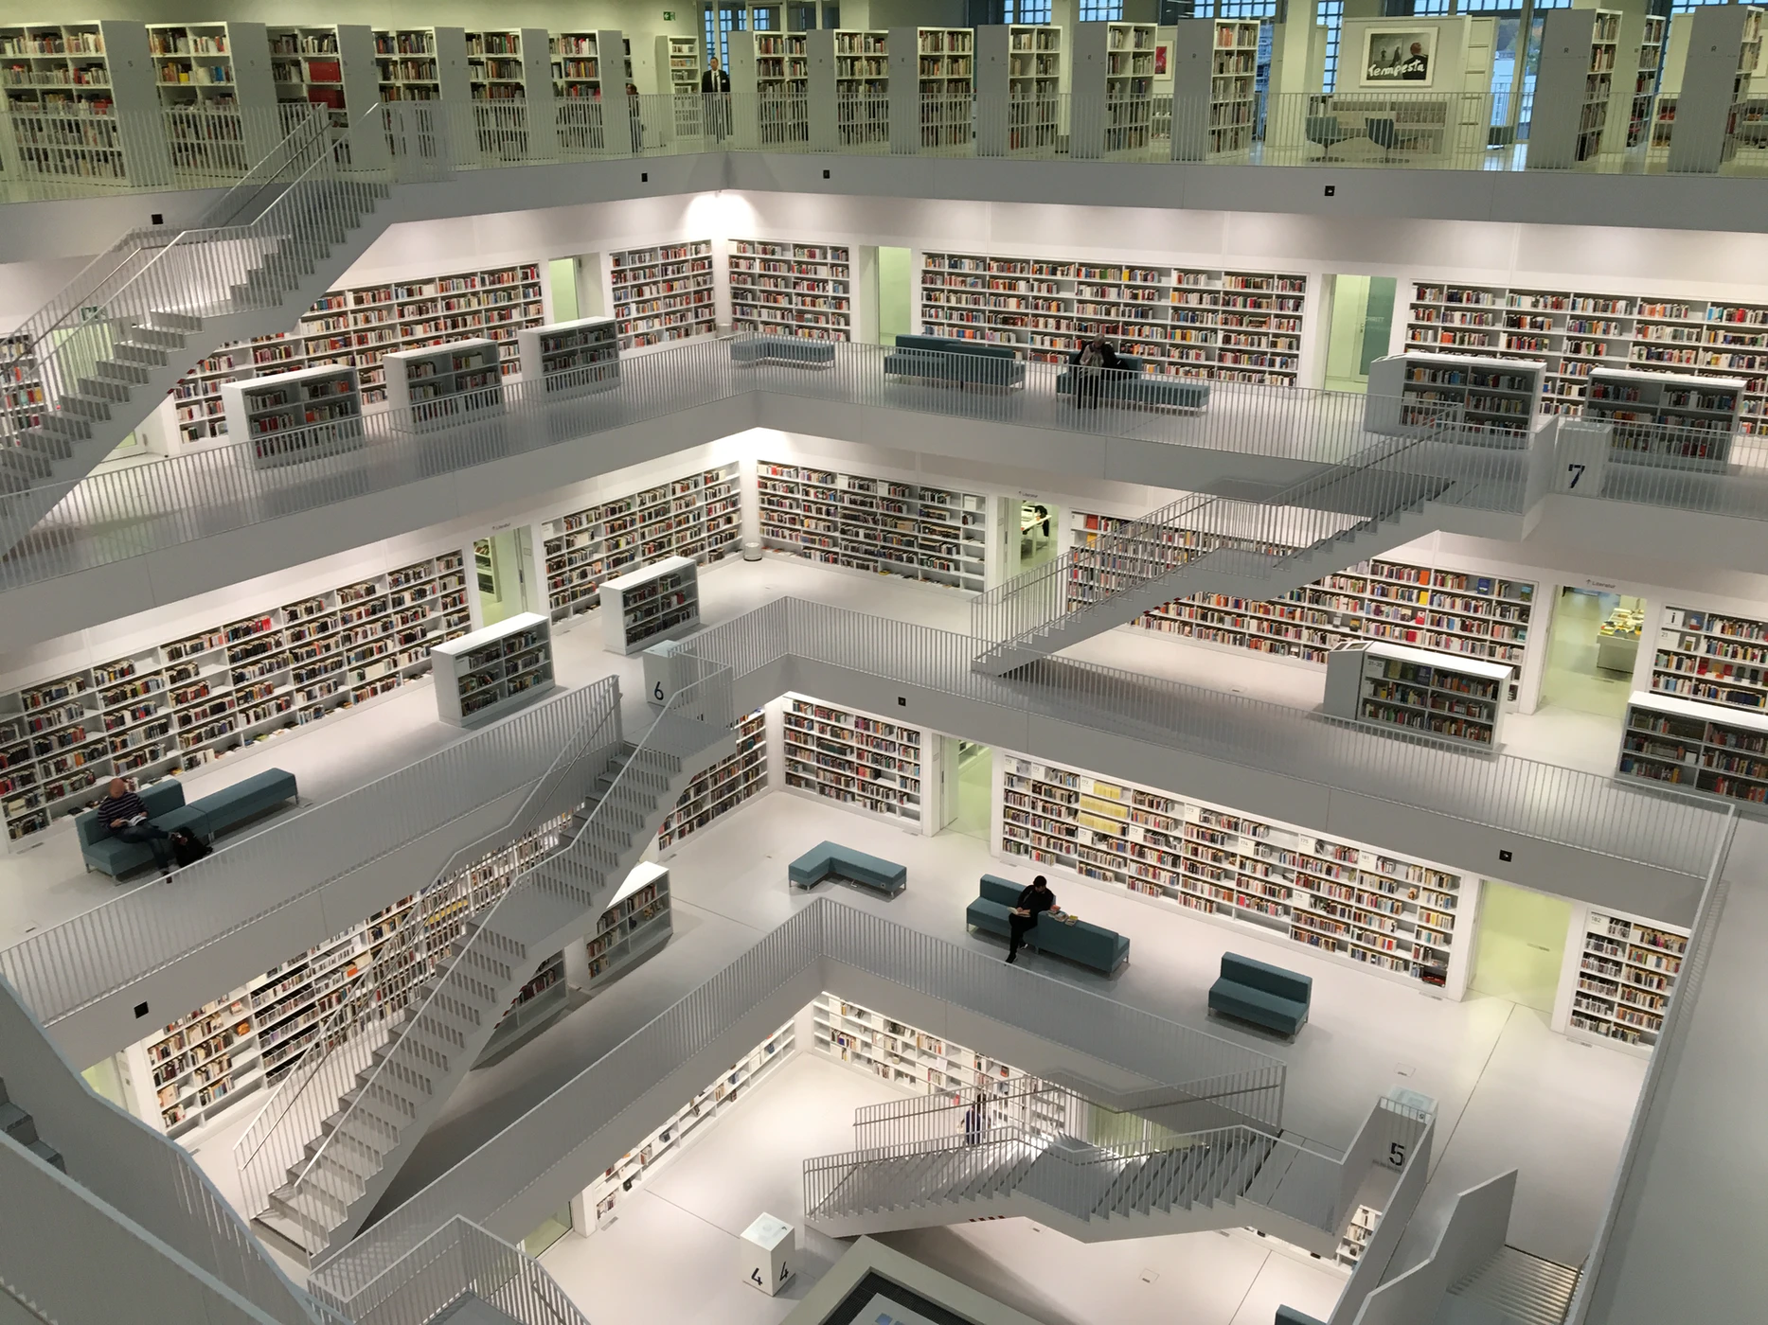
Databases as a Service
Source: Unsplash/Tobias Fischer under Unsplash License

Slide 25
DBaaS
Highly standardized across cloud providers.
Providers take care of the hard parts

Slide 26
ACID
Atomicity: transactions are all-or-nothing
Consistency: data is up to date
Isolation: transactions don’t affect each other
Durability: transactions are not lost

Slide 27
BASE
Basic Availability: always available
Soft-state: data can be non-consistent
Eventual consistency: transactions can be lost

Slide 28
CAP-theorem
C onsistency
A vailability
P artition tolerance

Slide 29
Relational / SQL databases (RDBMS)
articles
comments
id INT
title VARCHAR(255)
text MEDIUMTEXT
id INT
article_id INT
text MEDIUMTEXT

Slide 30
Key-value stores
foo: ZGdzZmdoZmdqZc2
bar: GpnaGpoZ2ZqaGdqZ
baz: mpqaGdma2hqZmxn

Slide 31
Document Databases
foo: {"text": "How do you comfort a JavaScript bug? You console it."}
bar: {"text": "Why did the developer go broke? Because he used up all his cache!"}
baz: {"text": "Why did the C# developer fall asleep? Because he didn't like Java."}

Slide 32
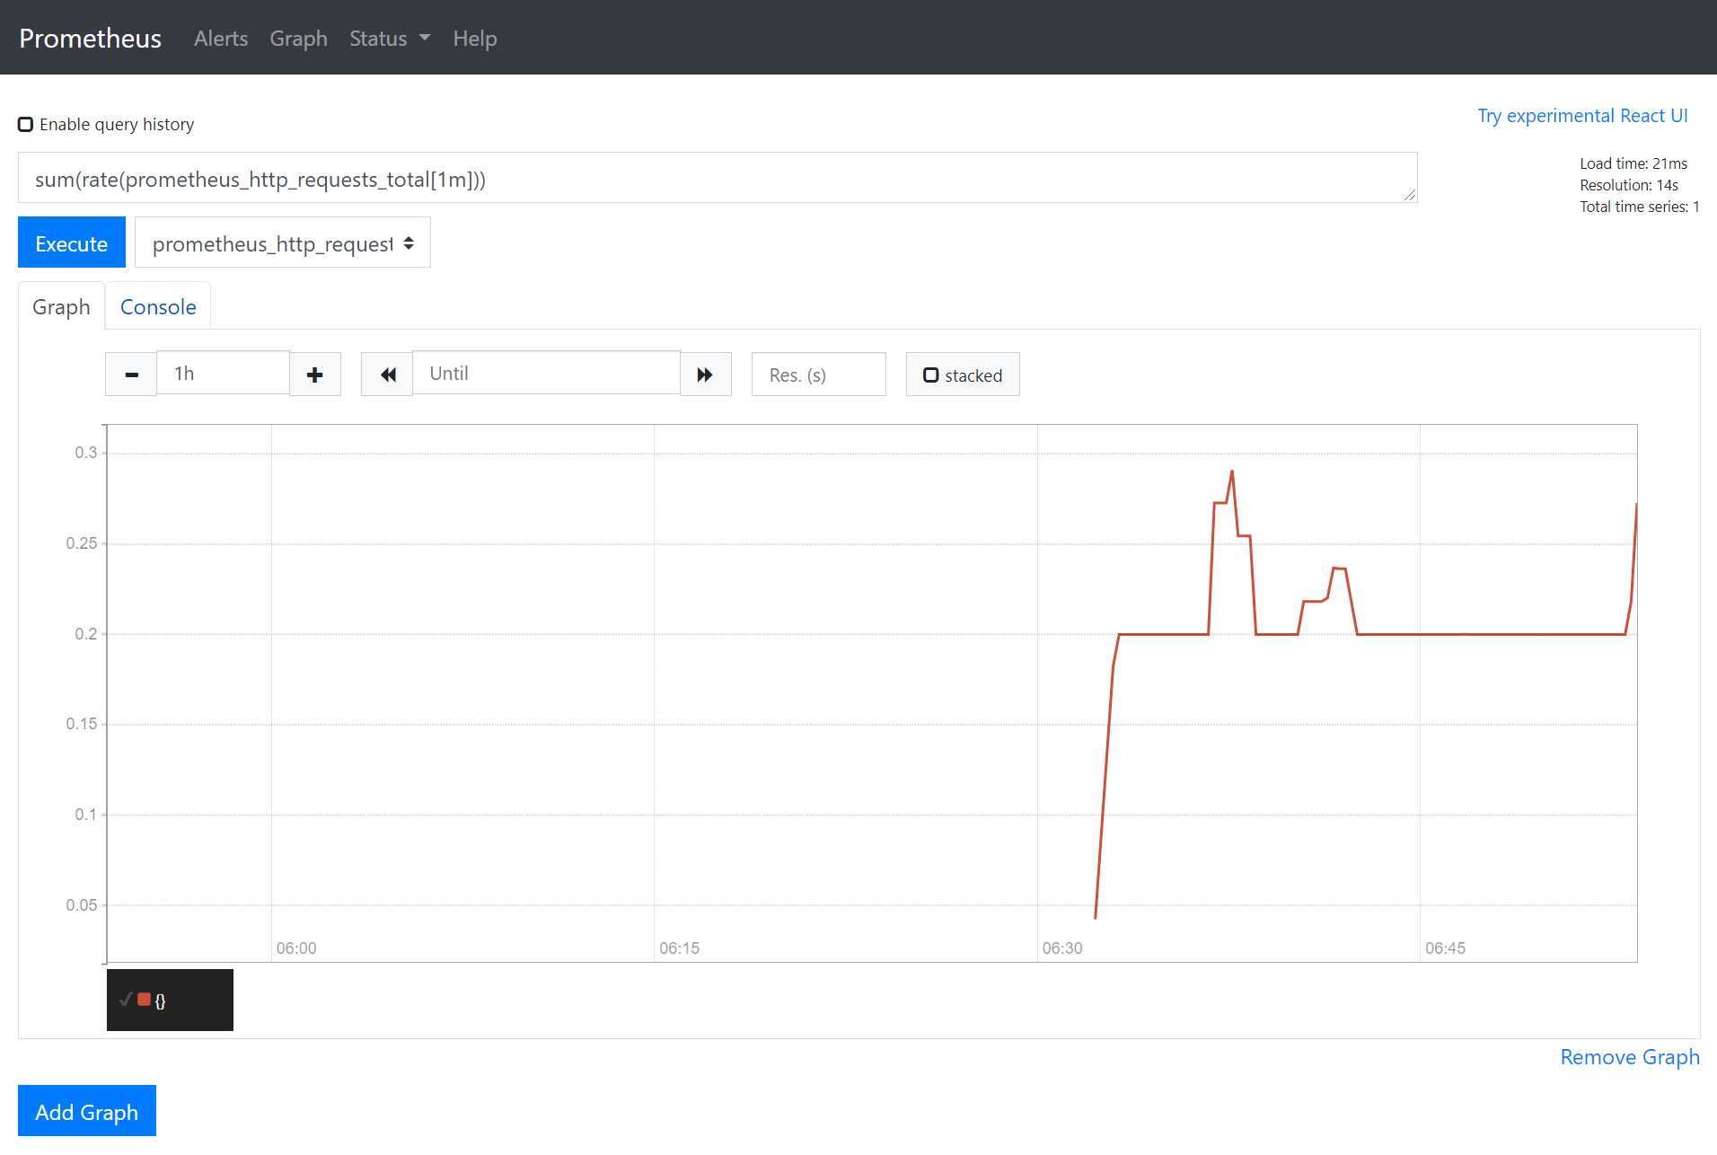
Time-series Databases

Slide 33
Graph Databases
Id: 100
Label: knows
Since: 2001-10-30
Id: 2
Name: Bob
Age: 22
Id: 101
Label: knows
Since: 2001-10-30
Id: 1
Name: Alice
Age: 18
Id: 105
Label: is_member
Since: 2011-02-14
Id: 104
Label: members
Id: 103
Label: members
Id: 3
Type: Group
Name: Chess
Id: 102
Label: is_member
Since: 2005-07-01

Slide 34

Functions as a Service
Source: Unsplash/Luca Bravo under Unsplash License

Slide 35
FaaS
HTTP
Database
Queue Message
Function
Object Storage
Trigger
Queue

Slide 36

Containers as a Service
Source: Unsplash/Chuttersnap under Unsplash License

Slide 37

Containers
Version Control System
CI/CD
Container Orchestrator
Application
Runtime
Registry
Worker Node
Container

Slide 38

Stream Processing & Business Analytics
Source: Unsplash/Hendrik Cornelissen under Unsplash License

Slide 39
Stream Processing
Source
Database
Analytics
Pipeline
Source
Database
Datalake
Source
Database

Slide 40

Deployment Pipelines
Source: Unsplash/Mike Benna under Unsplash License

Slide 41
Stream Processing
VM
Build
Test
Deploy
Container
VCS
Container

Slide 42

Thank you!
Source: Unsplash/Wilhelm Gunkel under Unsplash License

